Slide 1


The Art of Design Patterns
2023
Refactoring & Clean Code II
Prepared By:
Mohamed Samy &
Mariam Ahmed
Notes:
Greetings , welcome to the Art of design patterns + Who am I?

Slide 2
Agenda
Object oriented abusers
Switch Statements
Temporary Fields
Refused Bequest
Alternative Classes with Different Interface
Principles of Clean Code
Next Steps…

Slide 3
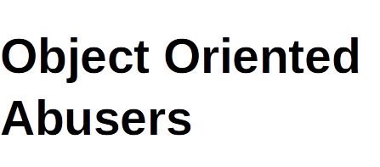

Slide 4
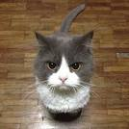
What will happen If you don't attend your oop lectures ??

Slide 5
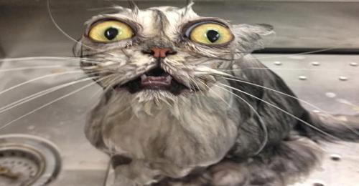
Not only you will fail in your exam.

Slide 6
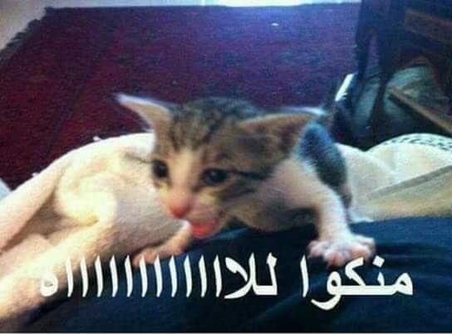
That will lead you to fall in Object Oriented Abuses :’)

Slide 7
Object Oriented Abusers are :
Programming anti-patterns that occur when developers misuse or misunderstand object-oriented programming principles, leading to code that is hard to maintain, understand, and extend.

Slide 8
Smells of incomplete or incorrect applications of object-oriented programming principles :
Switch Statement.
Temporary Field
Refused Bequest
Alternative Classes with Different Interfaces

Slide 9
Switch Statement :
Conditional complexity simply means a complex switch operator or a sequence of if-else statements.

Slide 10
Conditional Complexity issues :
Starts simple, but gradually harder to understand as logic is added.
Breaks the Open/Closed principle.
Testing Challenges.

Slide 11
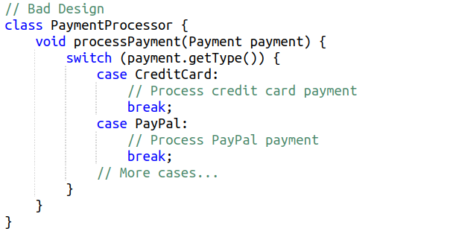
Example Code Smell :

Slide 12
What is the problems with this code !!
If you want to add a new payment type (e.g., "Apple Pay"), you would need to modify the PaymentProcessor method, violating the Open-Closed Principle.
As more payment types are added, the switch statement becomes longer and harder to manage.

Slide 13
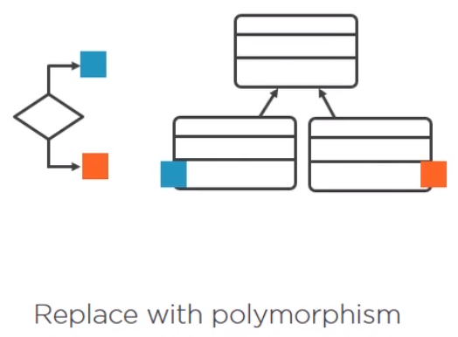
How to fix Conditional Complexity ?

Slide 14
A more object-oriented approach is to use polymorphism and inheritance to avoid switch statements. Each payment type should be represented by a separate class that inherits from a common interface, and you override a method to process the payment for each type.

Slide 15
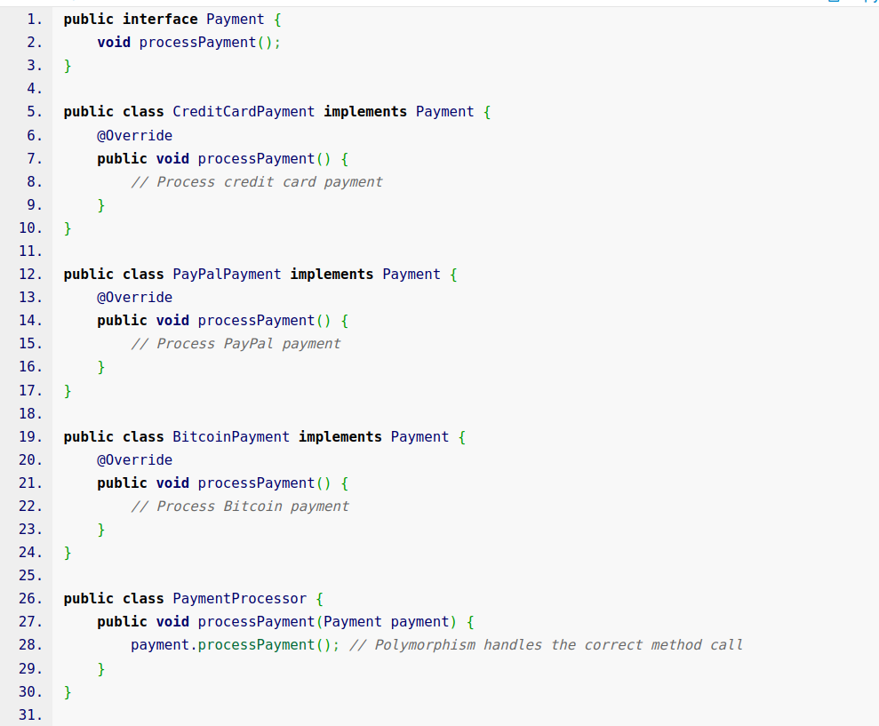
Fixing Code Smell :

Slide 16
Advantages of Better Solution :
Open-Closed Principle: You can easily add new payment types by creating new classes that implement the Payment interface, without modifying the PaymentProcessor class.
Code Clarity: Each payment type's logic is encapsulated within its own class, making the code easier to understand and maintain.
Testing: Unit testing becomes more straightforward since you can test each payment type in isolation.

Slide 17
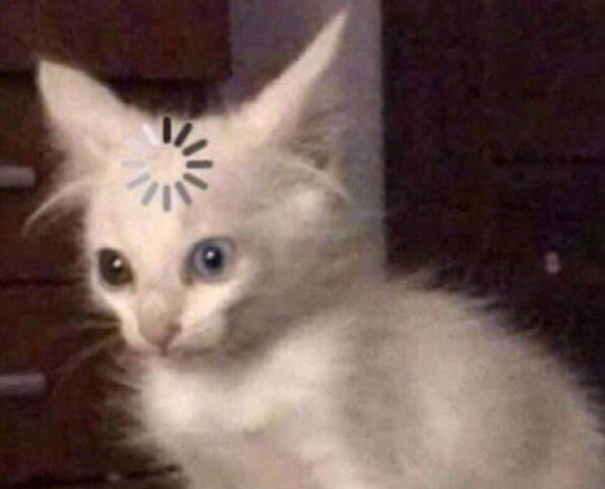
Can You Guess What Is this Design Pattern ??

Slide 18

You've Got It Right!

Slide 19

Strategy Pattern !!

Slide 20

Thinking Question ..

Slide 21

What Is the Difference between Polymorphism, Delegation and the Strategy Pattern ?

Slide 22
Wrapping up
Conditional complexity should be replaced with polymorphism or delegation and the strategy pattern.

Slide 23
Temporary Field :
The temporary field code smell occurs when we have one or more variables, or rather class fields, that are null most of the time and contain values only under certain circumstances.

Slide 24
Reasons for the Problem :
There are times the developer decides to introduce Fields in the Class which are used only by one Method, instead of passing it as method parameter to avoid Long Parameter List. These fields sit null in the class at all time, except when the particular method is used.

Slide 25
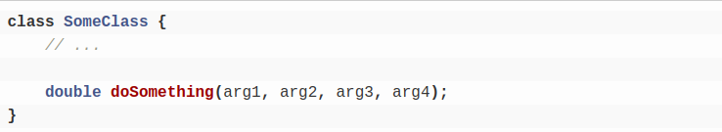
Example Code Smell :

Slide 26
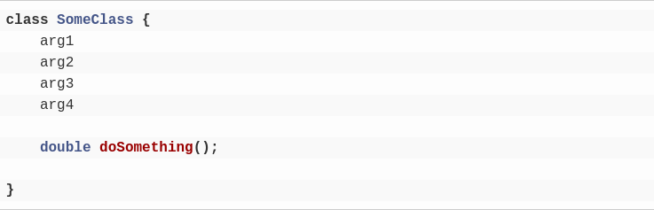
Continue :
We want to avoid the long parameter list, so what we could do is move these parameters out and make them class fields.

Slide 27
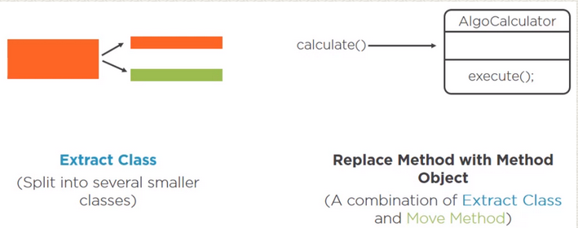
How to fix it ?

Slide 28
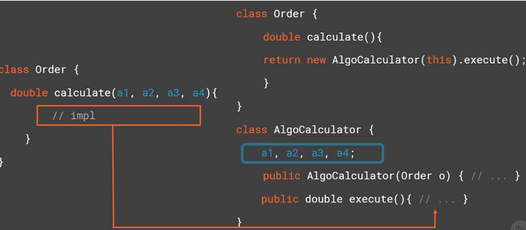
Continue :

Slide 29
Thinking Question ..

Slide 30
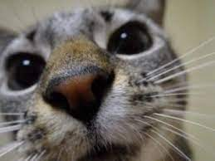
We still have our variables as class fields, so what is the difference now ?

Slide 31
Because this class is solely dedicated to one responsibility, computing our algorithm, these fields should contain data all the time or most of the time. So the issue of mostly empty fields is now gone.

Slide 32
Benefits :
Better code clarity and organization.

Slide 33
Wrapping up
- Conditional complexity should be replaced with polymorphism or delegation and the strategy pattern.
- Avoid temporary fields –> to solve this, we can move them and the related method to a dedicated class where they would be initialized all the time, so they would have data all the time.

Slide 34
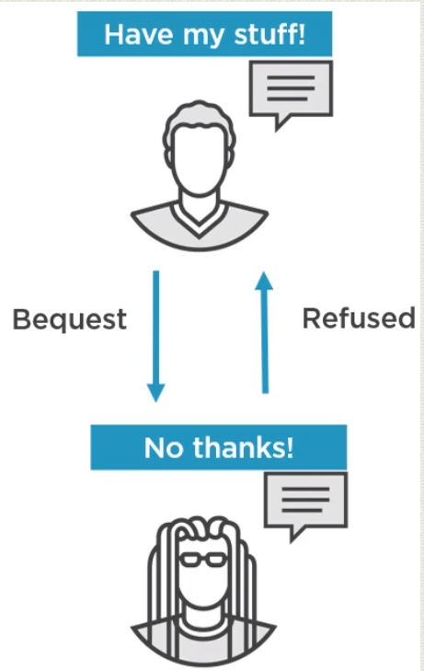
Refused Bequest :
What does Bequest mean ?

Slide 35
So, in the world of object oriented programming, a refused bequest happens when a subclass inherits fields and methods that it doesn’t need.

Slide 36
Reasons for the Problem :
Someone was motivated to create inheritance between classes to reuse the code in a superclass. But the superclass and subclass are completely different.

Slide 37
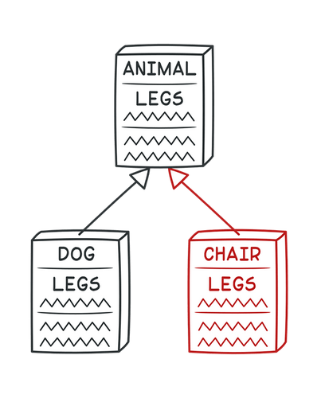

Slide 38
How to fix it ?
If inheritance makes no sense and the subclass really does have nothing in common with the superclass, Replace Inheritance with Delegation.
If inheritance is appropriate, Extract Superclass

Slide 39
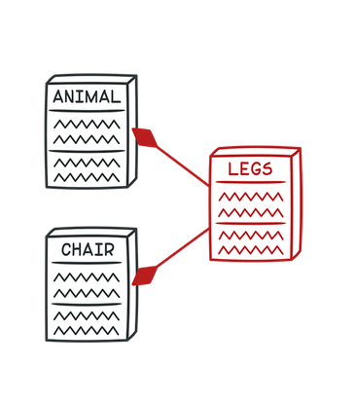

Slide 40
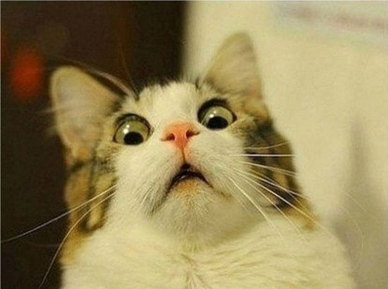
Benefits :
Improves code clarity and organization. You will no longer have to wonder why the Dog class is inherited from the Chair class.

Slide 41
Wrapping up
- Conditional complexity should be replaced with polymorphism or delegation and the strategy pattern.
- Avoid temporary fields –> to solve this, we can move them and the related method to a dedicated class where they would be initialized all the time, so they would have data all the time.

Slide 42
Wrapping up
- Subclasses should inherit only what we need.

Slide 43
Alternative Classes with Different Interfaces :
Two classes perform identical functions but have different method names or the method signature

Slide 44
Reasons for the Problem :
Such situation arises mostly when there is lack of communication between team members who end up developing similar classes, or when the developer fails to check the available classes so he didn’t know that a functionally equivalent class already existed.

Slide 45
How to fix it ?
Thus one solution is to create an abstract class or an interface, and let these classes extend or implement it .
The point is to group and link related classes so they’re not entirely disconnected.

Slide 46
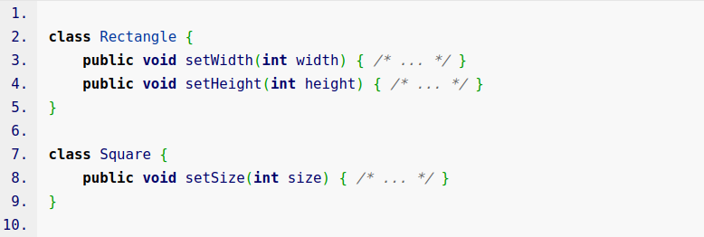

Slide 47
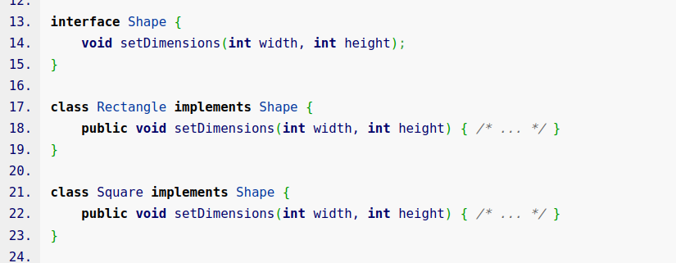

Slide 48
Note That :
There would be other times when only a part of the classes are similar, leading to usage of Extract SuperClass.

Slide 49
But we can’t always bring two different implementations under one roof. Sometimes it doesn’t make sense to bring these classes together. In that case, just remove one and keep the other .

Slide 50
Example Code Smell :
For example, we have a requirement about displaying the price in dollars, and in the customer’s local currency if they are not based in the US. And we have our old code:

Slide 51
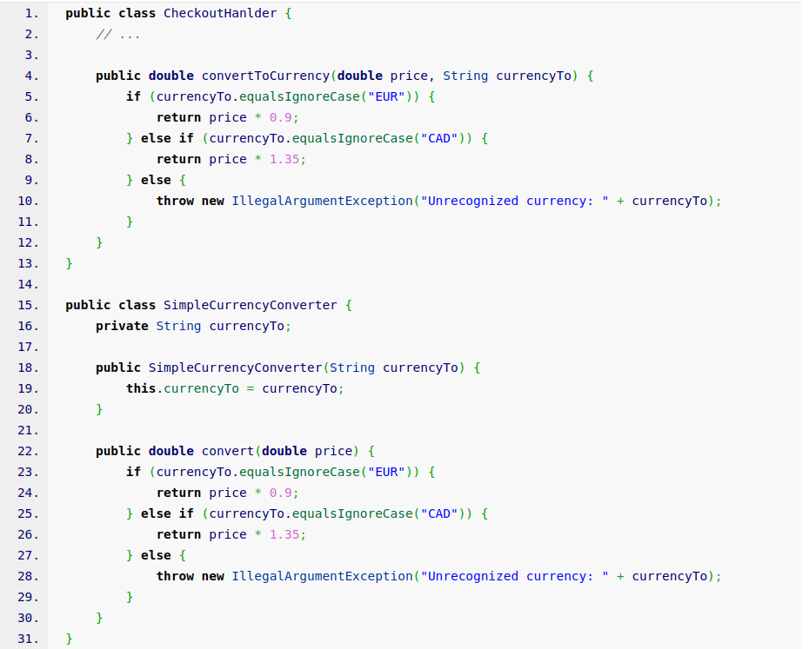

Slide 52
Continue :
SimpleCurrencyConverter and CheckoutHanlder have the same implementation about converting currency. In this case, we will not use common abstract class or interface for two classes as it would not make sense.
So we’re going to keep our dedicated SimpleCurrencyConverter class, and remove the method from our CheckoutHanlder class. Then, we need to replace that method with the only implementation remaining.

Slide 53
Thinking Question ..

Slide 54

Why We Remove the Method from CheckoutHandler Class not SimpleCurrencyConverter Class ?

Slide 55
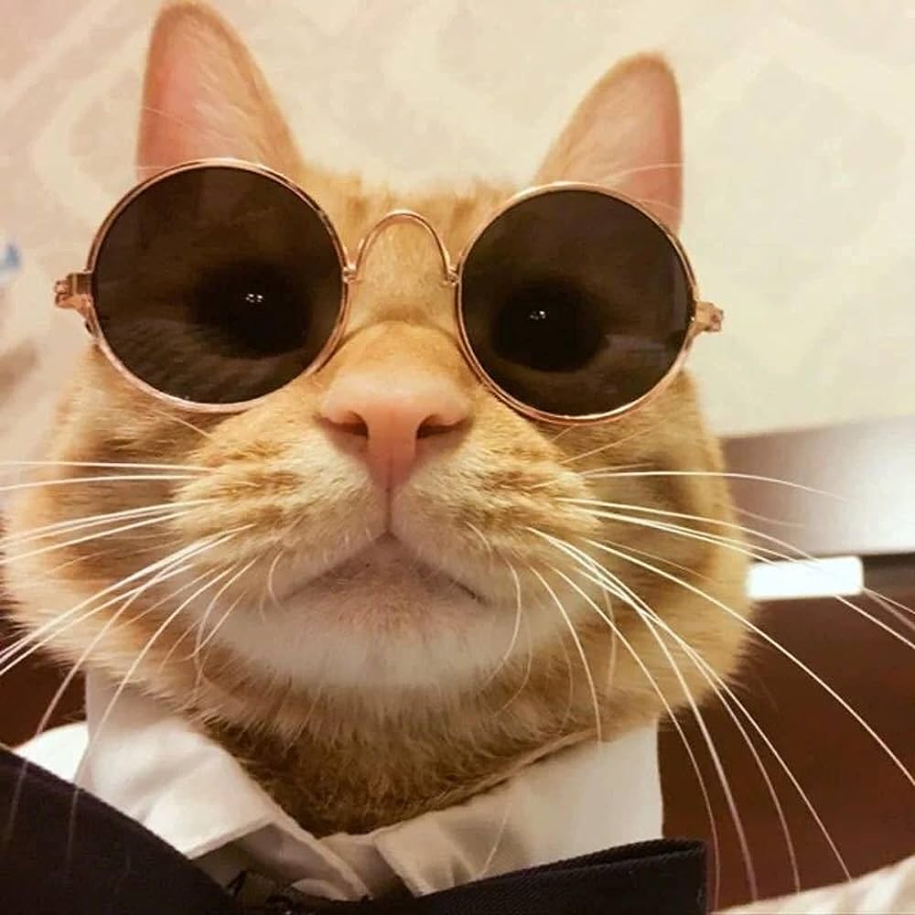
Single Responsibility Principle !!

Slide 56
Benefits :
You get rid of unnecessary duplicated code.
Code becomes more readable and understandable (you no longer have to guess the reason for creation of a second class performing the exact same functions as the first one).

Slide 57
Wrapping up
- Conditional complexity should be replaced with polymorphism or delegation and the strategy pattern.
- Avoid temporary fields –> to solve this, we can move them and the related method to a dedicated class where they would be initialized all the time, so they would have data all the time.

Slide 58
Wrapping up
- Subclasses should inherit only what they need.
- Keep a single solution for one task.

Slide 59
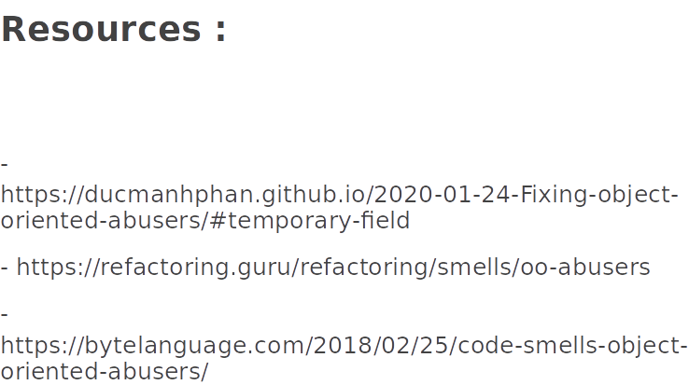

Slide 60
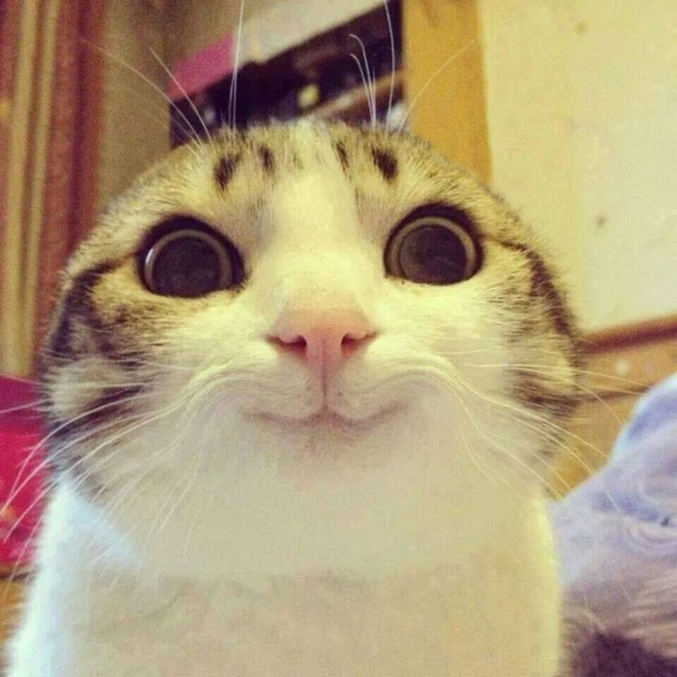
Any Questions !!

Slide 61

10 Minutes Break

Slide 62

Principles of Clean Code
Clean Code:
Clean code refers to well-structured, readable, and maintainable code that follows established principles and best practices.

Slide 63
Principles of Clean Code
Follow Standard Conventions
Coding, architecture, design guidelines
Using a good IDE can help

Slide 64
Coding Conventions in Java: Naming
Class Names: Use PascalCase for class names. Start each word with an uppercase letter, e.g., MyClass, EmployeeDetails.
Method Names: Use camelCase for method names. Start with a lowercase letter, and capitalize the first letter of subsequent words, e.g., calculateTotal, printDetails.
Variable Names: Use camelCase for variable names, following the same rules as method names, e.g., totalCount, employeeName.
Constants: Use uppercase letters with underscores to separate words for constant names, e.g., MAX_VALUE, PI.

Slide 65
Coding Conventions in Java: Braces and Indentation
Use an opening curly brace { at the end of the line where a block starts
Closing curly brace } on a line by itself aligned with the code that started the block.
Indent code inside blocks with spaces or tabs for readability. Generally, 4 spaces are used for each level of indentation.

Slide 66
Coding Conventions in Java: Whitespace
Use whitespace to separate operators and operands for clarity, e.g., int result = a + b;
Add spaces after commas in method arguments and declarations, e.g., printDetails("John", 25);
Avoid trailing whitespace at the end of lines.

Slide 67
Coding Conventions in Java: Comments
Include comments to explain complex logic, algorithms, or any non-trivial code sections.
Use JavaDoc comments to document classes, methods, and their parameters, return values, and exceptions.

Slide 68
Coding Conventions in Java: Imports
Organize import statements at the top of the file, grouped in the following order:
Java standard library imports.
Third-party library imports.
Your own project's imports.

Slide 69
Coding Conventions in Java
Line Length
Keep lines of code reasonably short, typically around 80-120 characters. This enhances code readability.
Use of Parentheses:
Use parentheses to clarify the order of operations and improve code readability, even when they are not strictly necessary.

Slide 70
Coding Conventions in Java
Class Structure:
Organize classes and methods in a logical and consistent manner.
Follow a recommended structure: package declaration, imports, class/interface declaration, member variables, constructors, methods.
Error Handling:
Use appropriate exception handling mechanisms, such as try-catch blocks, to handle exceptions effectively.

Slide 71



Principles of Clean Code
Keep it Simple, Stupid (KISS)
Simpler is always better. Reduce complexity as much as possible.
Boy Scout Rule
Leave the campground cleaner than you found it.
Root Cause Analysis
Always look for the root cause of a problem. Otherwise, it will get you again

Slide 72
Principles of Clean Code: Naming
Choose Descriptive / Unambiguous Names
Names must reflect what a variable, field, property stands for.
Choose Names at Appropriate Level of Abstraction
Choose names that reflect the level of abstraction of the class or method you are working in.
Name Interfaces After Functionality They Abstract
The name of an interface should be derived from its usage by the client Eg: Serializable , IQueryable

Slide 73

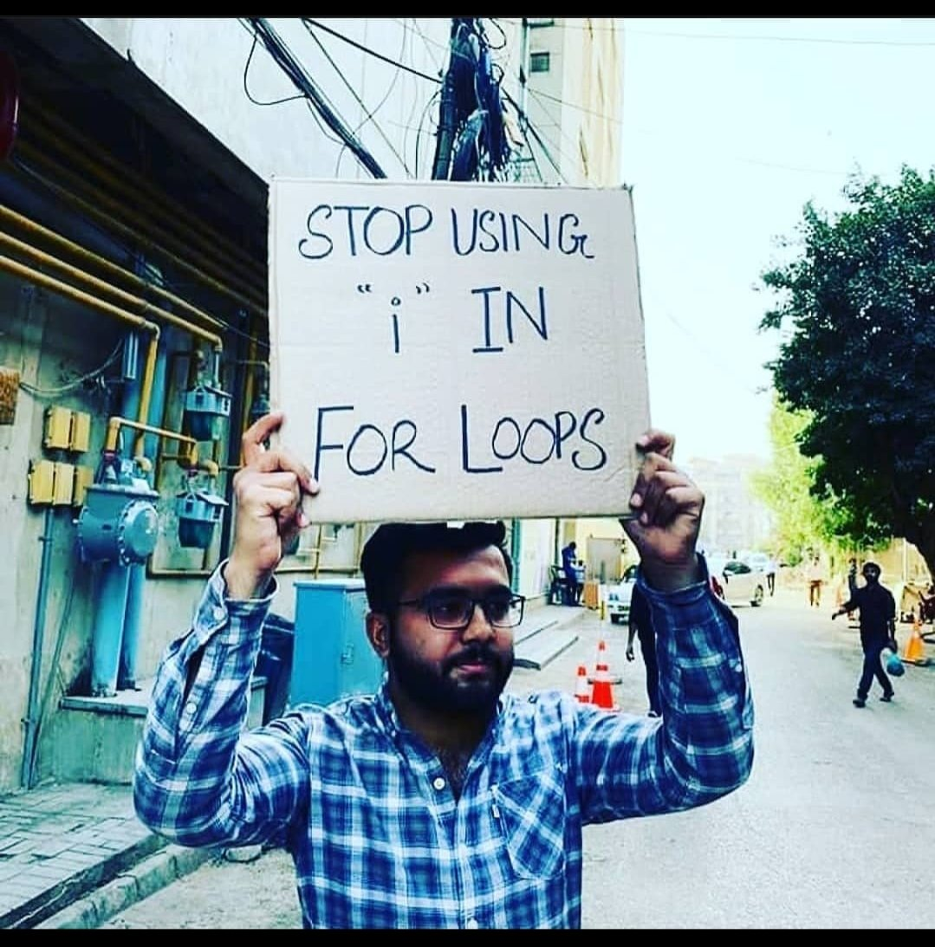
Is he right 🤔?

Slide 74
Principles of Clean Code: Naming
Name Methods After What They Do
The name of a method should describe what is done, not how it is done.
Use Long Names for Long Scopes
fields => parameters => locals => loop variables
longest --------------------------------------> shortest
Standard Nomenclature Where Possible (Follow The Conventions)
Don’t invent your own language when there is a standard.

Slide 75
Principles of Clean Code: Naming
NO Encodings in Names : NO prefixes, no type/scope information
In most cases, This is the right thing to do unless the language conventions suggests otherwise
Encoding is correct in cases like:
In C#: Interfaces are prefixed by letter I, Eg: Ilist
In C/C++ and VisualBasic : Hungarian Notation maybe used

Slide 76

Extra Knowledge: Hungarian Notation
The main idea behind Hungarian notation is to include a prefix or a short code in the names of variables, functions, or other entities to indicate their data types, usage, or other characteristics
Eg: iCount -> int,
strName -> string,
btnSubmit -> Instance of Button class

Slide 77

Principles of Clean Code: Comments
Rule #1 in comments:
“The Best comments are the ones you don’t have to write”

Slide 78
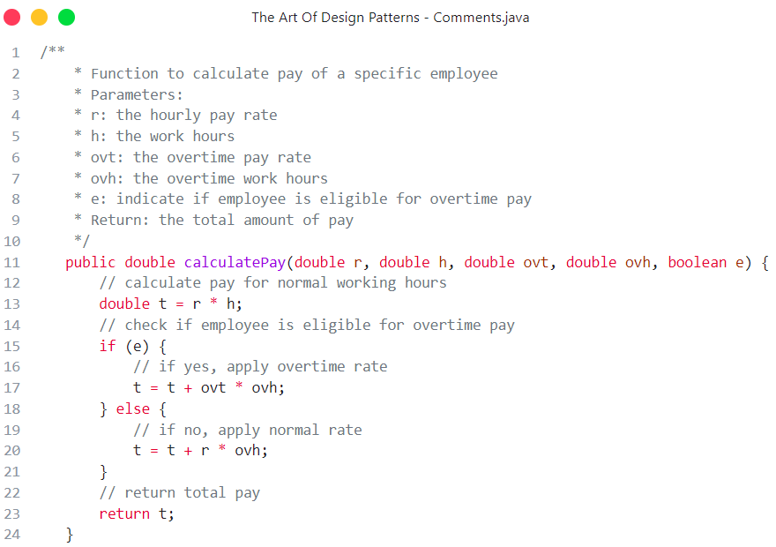
Javadoc Comments
What is that ???!

Slide 79
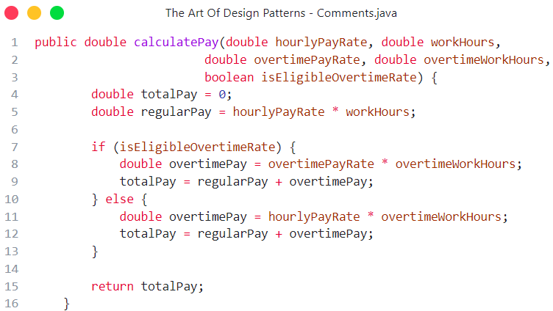
Principles of Clean Code: Comments
Best approach
Rule #1 in comments:
“The Best comments are the ones you don’t have to write”

Slide 80
Principles of Clean Code: Comments
Comments can lie: Code may be modified without the comments so make sure to update them accordingly
Explain the Why, Not the What: Comments should focus on explaining the reasoning behind a particular approach rather than restating what the code is doing. The code should be self-explanatory.
Use Language Documenting comments if needed Ex: Javadoc

Slide 81

DRY (Don't Repeat Yourself) ✅:
“A piece of information (such as logic, code, or data) should have a single, authoritative representation in the software”
Promotes for the Elimination of redundancy in code.
Reduces the risk of inconsistencies, decreases the maintenance effort
Improves code readability.
Encourages to reuse code through functions, classes, and modules instead of duplicating it across different parts of your program.

Slide 82

YAGNI (You Ain't Gonna Need It):
“You should only implement the features that are necessary for the current requirements”
Don’t try to implement every possible future requirement.
Avoid over-engineering and unnecessary complexity.
Focus on what is needed right now
Avoid spending time on features that might never be used.

Slide 83
What’s Next 🤔?
By now you should already know:
SOLID Principles
9 Design Patterns
2 Code Smells and their Refactoring techniques
Clean Code

Slide 84
What’s Next 🤔?
But there is still more to learn & practice:
The Remaining GoF Design Patterns, By now this should be easy for you ✅
Read the Books 📖
Practice on your own project and refactor old ones 🏗️

Slide 85

What’s Next 🤔?
We are still here for you:
You can always ask for help on Discord server and help the others as well…

Slide 86


What’s Next 🤔?
Looking Forward to seeing your awesome projects 👀:
Top 3 teams will be announced and get certificates
Projects will be discussed on Saturday 2/9
If you can’t make it contact me on discord before Friday

Slide 87
The Art of Design Patterns
Thanks for listening ❤️
This Is The End Enjoy Mastering…
Brought to you by : Science and Tech Committee of OSC - ASU
Notes:
Greetings , welcome to the Art of design patterns + Who am I?

